Slide 1
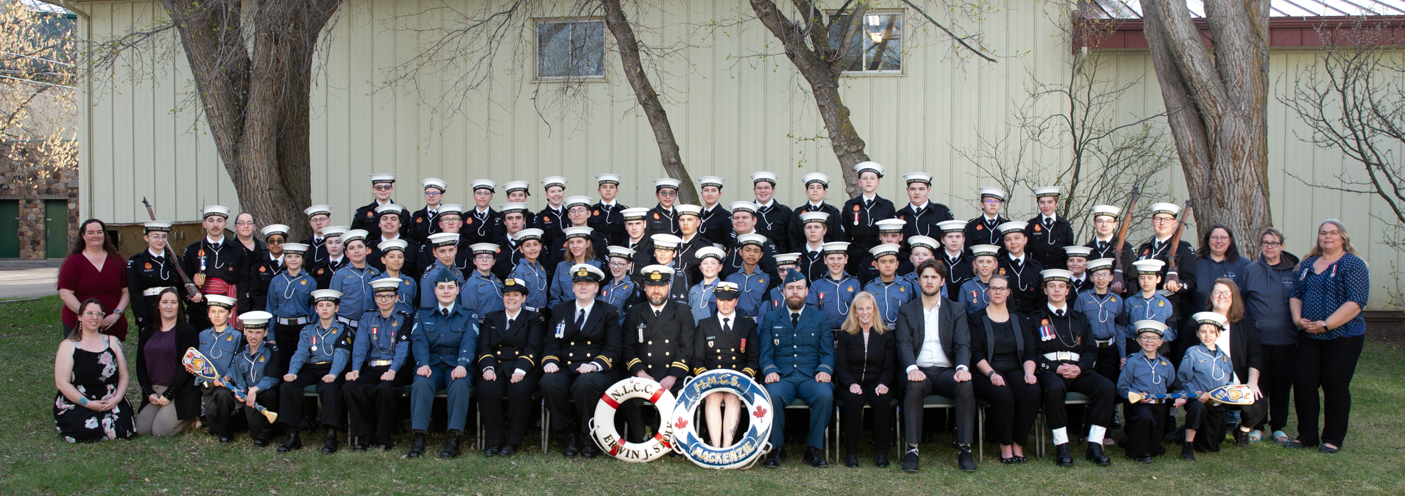
Parent Meeting
September 23, 2026

Slide 2
Agenda
Message from the President
Payment Methods
R E S P E C T
Sea Cadet Presentation
Our Fundraising Program
Navy League Presentation

Slide 3

MESSAGE FROM THE PRESIDENT
NAVY LEAGUE OF CANADA
STONY PLAIN BRANCH
Welcome Back
Branch Introduction

Slide 4
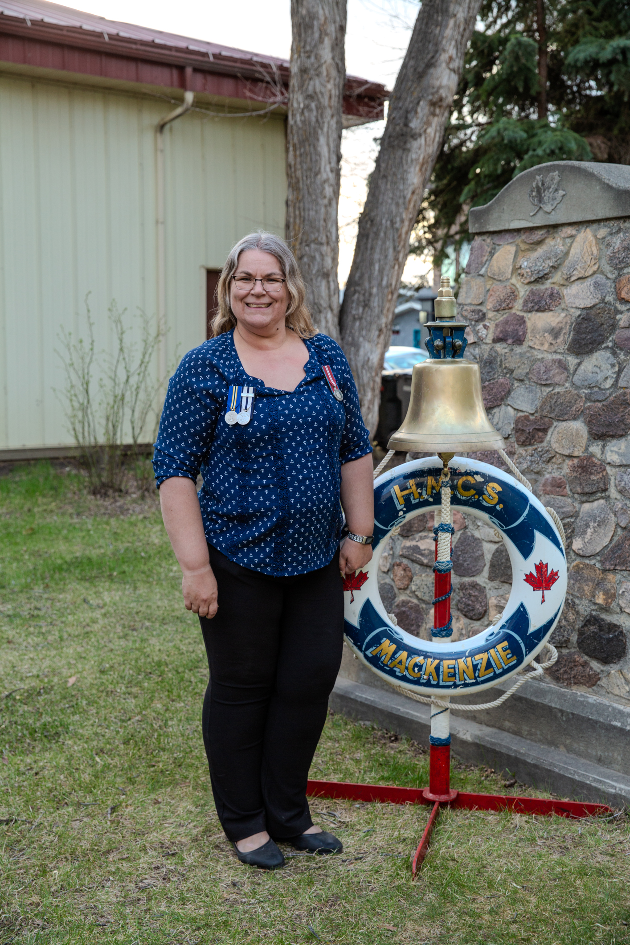
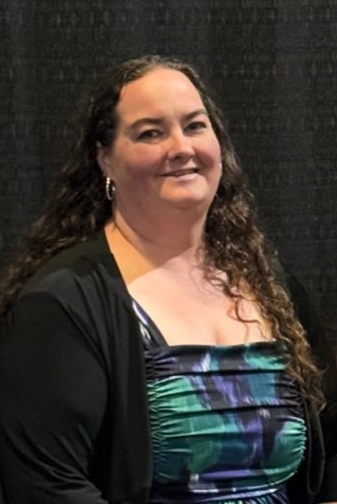
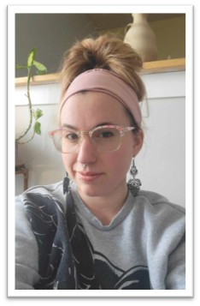
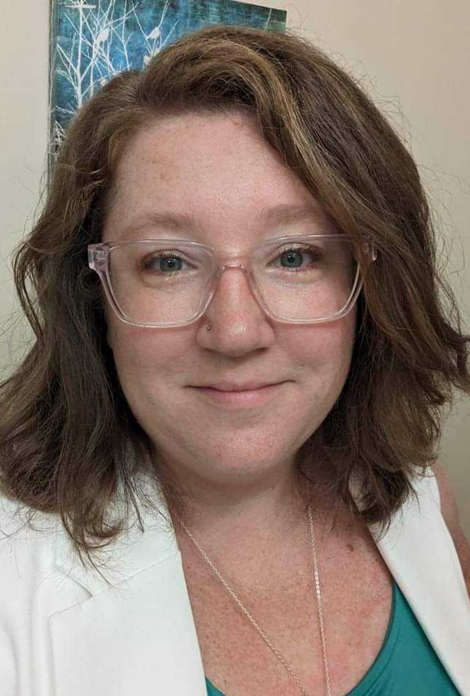
The executive
Amanda Hall
President
Yvette Gogowich
Vice President
Christina Bugyra
Secretary
Jennifer Geddes
Treasurer

Slide 5
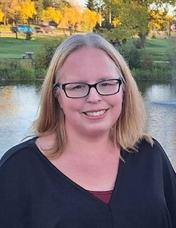


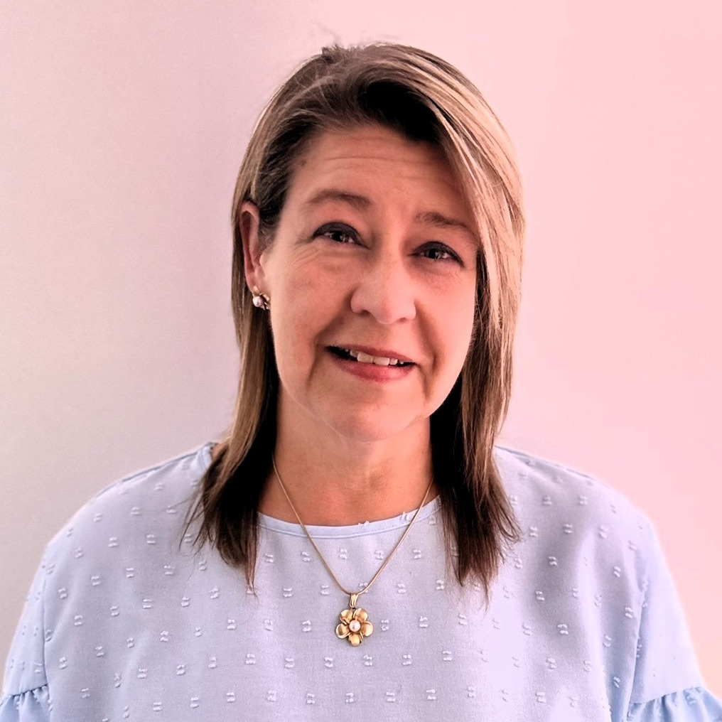
Directors at large
Nadia Bit
Stores/Casino Chair
Lei Gryshik
Parent Liaison
Angela Sharp
Fundraising
Chantal McKenzie
Director at Large

Slide 6
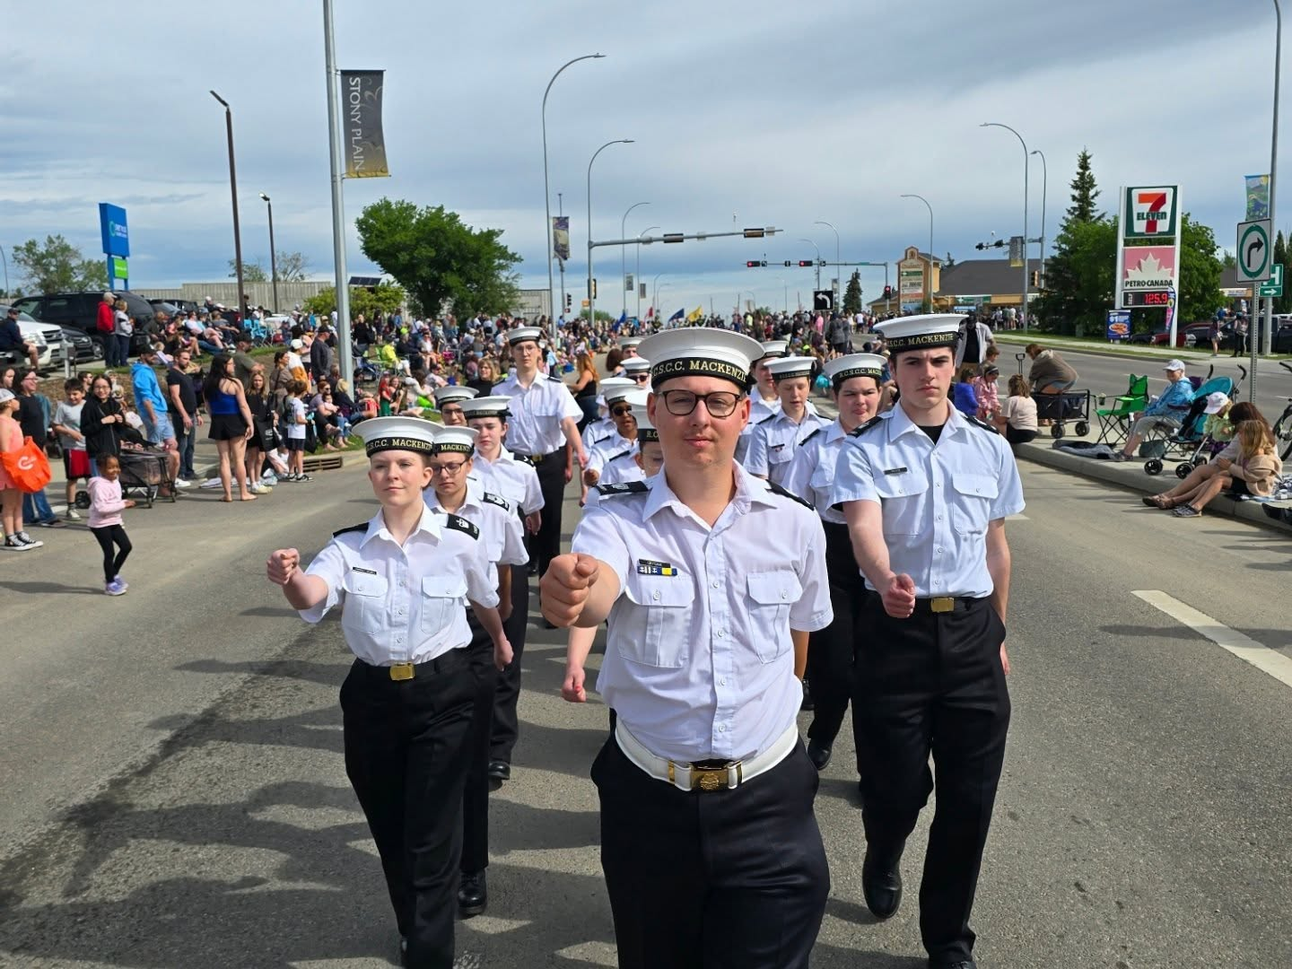
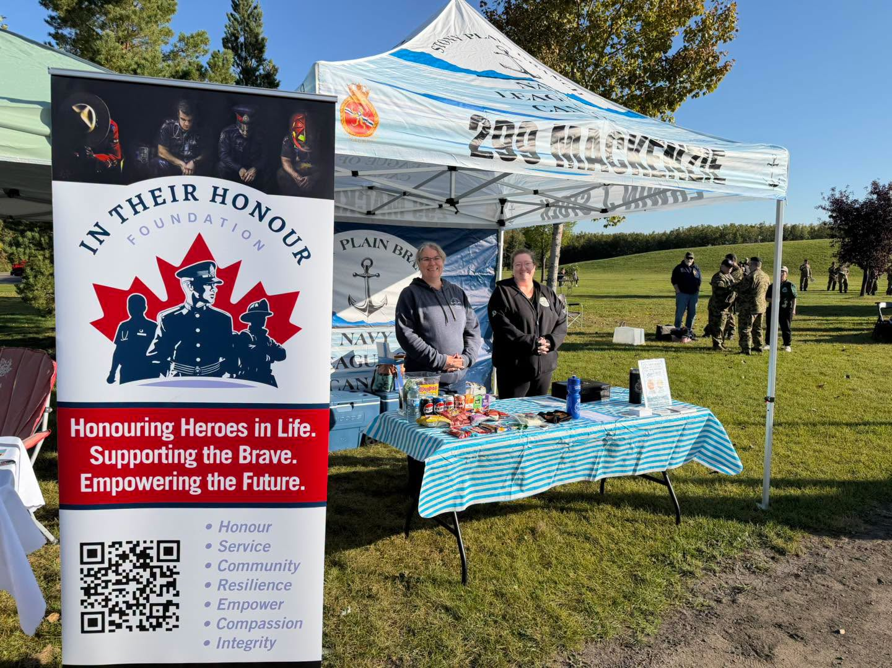
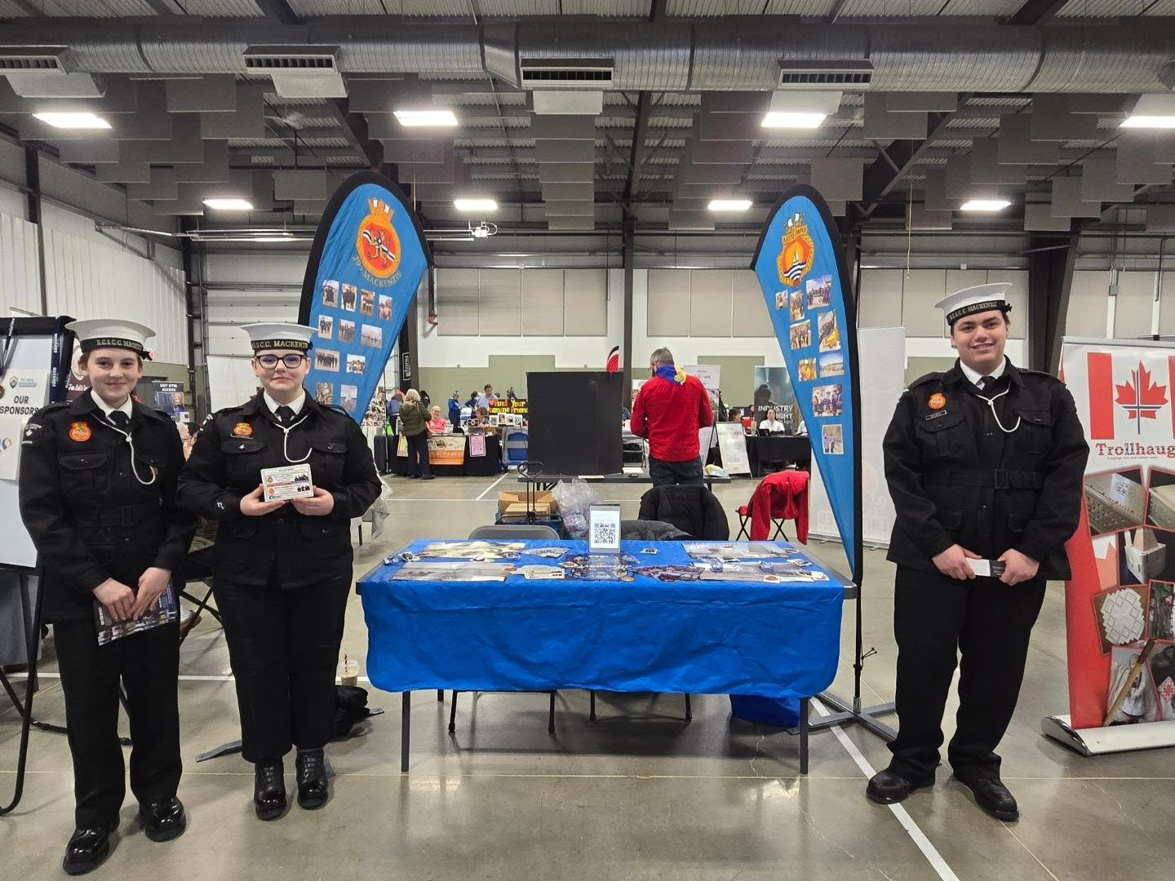
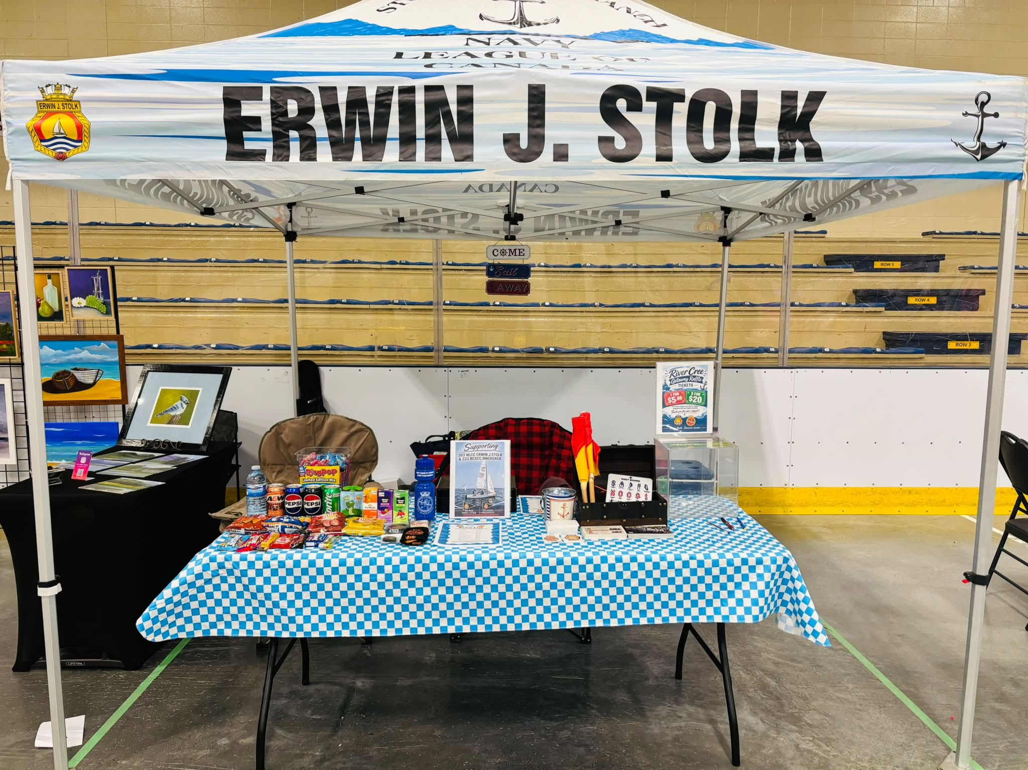
Community is key

Slide 7
Our Fundraising Program
THE BRANCH
Our program is a Non-Profit Society run by a Parent volunteer group called the 'Branch'. All funds raised go directly back into the program to support our amazing cadet corps. Annually, we have several regular supporters to our program and a few grants which we apply for, but we rely heavily on fundraising by Cadets and the Parent group. Each year the Branch executive sits down and designs a ROBUST Fundraising program for the cadets to work with monthly.
JOIN US!!!
MONTHLY FUNDRAISING
All families are required to fundraise a profit of $65.00 a month for their family account. This amount helps to cover our program costs as outlined by our annually prepared budget. Each fundraiser is carefully vetted to get the maximum profit to our cadets.
Cadets also have their own individual accounts. Once their monthly requirement is met, a cadet can fundraise directly for their own accounts. This account gets used for our larger cadet trips or can be used as requested towards future monthly family account requirements.

Slide 8
Why do we fundraise so much?
It supports the program for your child. On average, if a cadet does every event in the year, it costs the corps/branch anywhere from $900 to $1000.00 per cadet
Let's look at the whole picture (Numbers are just to give you an idea)
83 Cadets
x
$900.00/year
Total = $74,700.00

Slide 9
Why do we fundraise so much?
The way we do fundraising, it is $65.00 a month per family. This can be achieved by selling or volunteering for events, like the Bingos etc. There is always the option of just paying monthly or upfront at the beginning of the year.
57 Families
x
$65.00/month
Total = $3,705.00
10 months in a training year
x
$3,705.00
Total = $37,050.00
$74,700.00
-
$37,050.00
Difference of = $37,650.00

Slide 10

Fundraisers
Ongoing Fundraising
Fundraising Ideas
Ongoing Chocolate Covered Almonds (one case covers the $36.00 for the month)
Charity Casino in St. Albert – November 9 & 10
Family Bingo (November, February and April)
Adult Only Social – March 20, 2027
Skip the Depot
Flip Give
Cookie Dough (59 Minute Fundraiser)
Liquor Raffle
Mundare Meats
Popcorn
Purdy’s
Approach companies for cash donations
Apply for more grants
Always open to more Ideas!

Slide 11
Why do we fundraise so much?
Now we are fortunate to get some support for the Sea Cadets. All their mandatory training is covered by the Canadian Armed Forces (CAF). However, anything extra falls on the branch. We also can claim LSA (Local Support Allocation) We need to spend the funds first and then submit for a reimbursement. That is about $2,000.00 to $3,000.00 a year. However, we need to spend the money first.
The corps also get donations from the Legions that support them.
Stony Plain for Sea Cadets and Spruce Grove for the Navy League
The branch also looks for grants we are eligible for. We will also send letters to businesses who want to donate to help with the expenses. If you know of any, please let us know.
The cadet program is a very cost-effective program that gives your children amazing
lifelong skills. Your support as a parent matters more than you think.

Slide 12
Fundraising Commitment
I know, I know it seems like we ask a lot. But we have set up ways to be able to make it work.
Option One - Pay $65.00 a month
Option Two - Sign up to work events, like Bingos, Social etc.
Option Three – Pay $650.00 for the whole year
Of course you can do all options. Whatever works for your family.
See us if you have questions

Slide 13

Payment Methods for Fundraising / Program Costs
  E-Transfer
    stonyplaintreasurer@abnavyleague.ca
  Cash / Cheque at Branch Table
  All E-transfers Must Have A Message With Cadet Name And Fundraiser Identification
  All Cash / Cheques Must Be Placed In An Envelope At Branch Table Labeled With Cadet Name And what the funds are for
  Cheques Are To Be Made Out To: Nloc Stony Plain Branch
As a charitable organization, The Navy League of Canada is regulated by AGLC.
Strict rules & guidelines around Raffles, Bingos & Casinos.
Our procedures and paperwork can be randomly audited by AGLC.

Slide 14

“Respect should be the first thing you give”
The Navy League of Alberta – Stony Plain Division is run by volunteers! We make time out of our day to get’er done!
All Questions & Concerns should be handled via Amanda Hall (Branch President), Jamie Rupert (Sea Cadet CO), or Jurgen Stolk (Navy League CO) first and foremost!
  Amanda Hall- stonyplainpresident@abnavyleague.ca
  Jamie Rupert- jamie.rupert@cadets.gc.ca
  Kayla Thorne- co.nlcc.ejstolk@abnavyleague.ca
As always – Branch Executive is available Wednesday nights at the table in the foyer of the Ship (Hall)!

